Slide 1

Rain world: the boardgame RULEBOOK (and help book)
Version: 1.01
Dlc: None

Slide 2
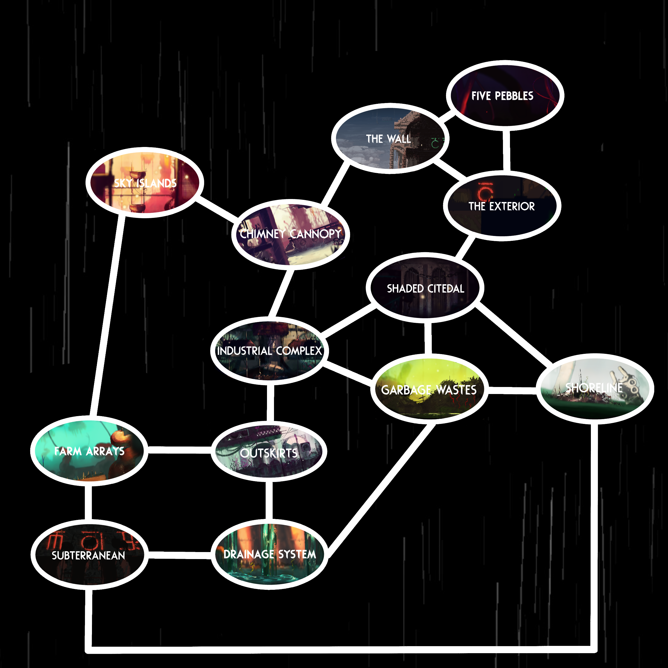
Overview
Rain world: the board game, is a game based off the original rain world base game with hints of downpour aspects (DLC).
This overview will go over the aim of the game and some other aspects.
The aim of the game is to ascend your slugcat before the opposing player. alternatively, you can also play by yourself and try to ascend in as little turns as possible.
(This game has not been play tested yet)
This game is playable with up to 9 players. (More players will make for a much longer game).
The average playtime for the game (4 players) is about 2 hours.
Make sure to read the rules before starting the game but feel free to make up your own if you want to.
If you are confused about anything, there is probably a page on it. If not leave a reply in the steam workshop submission.
I hope you enjoy my game! - Hunter.

Slide 3
Layout
I like, don’t have anything here yet haha

Slide 4
Rules:
You must start in the starting location of your chosen slugcat (balancing reasons)
Go over the game mechanics in the mechanics section of this book if you are not sure what to do with an item or event.
Only pickup from the deck of the region you are currently in.
Have fun!
Mechanics:
- Labelled Cards
- CYCLES
- Precycles
- Rain
- Hibernation
- Turns
- Karma
- Regions
- combat
- Scavengers
- Unique things

Slide 5
Beginning the game
Roll a d20 to decide turn order.
Players take turns picking a slugcat card and takes their respective food board in turn order.
Move every player tile to their starting regions if not there already.
Everyone take a karma 1 token.
Roll to decide the cycle timer (see CYCLES)
Everyone start taking their turns! (see Turns)
ending the game
Reach Five pebbles (See regions) and draw a mark of communication
Reach subterranean
Shelter twice in subterranean
Wait four turns* (you don’t need to play them)
Ascend and win the game!
* you wait four turns so that others may also ascend before the game ends, skip this if step if you don’t really care.

Slide 6
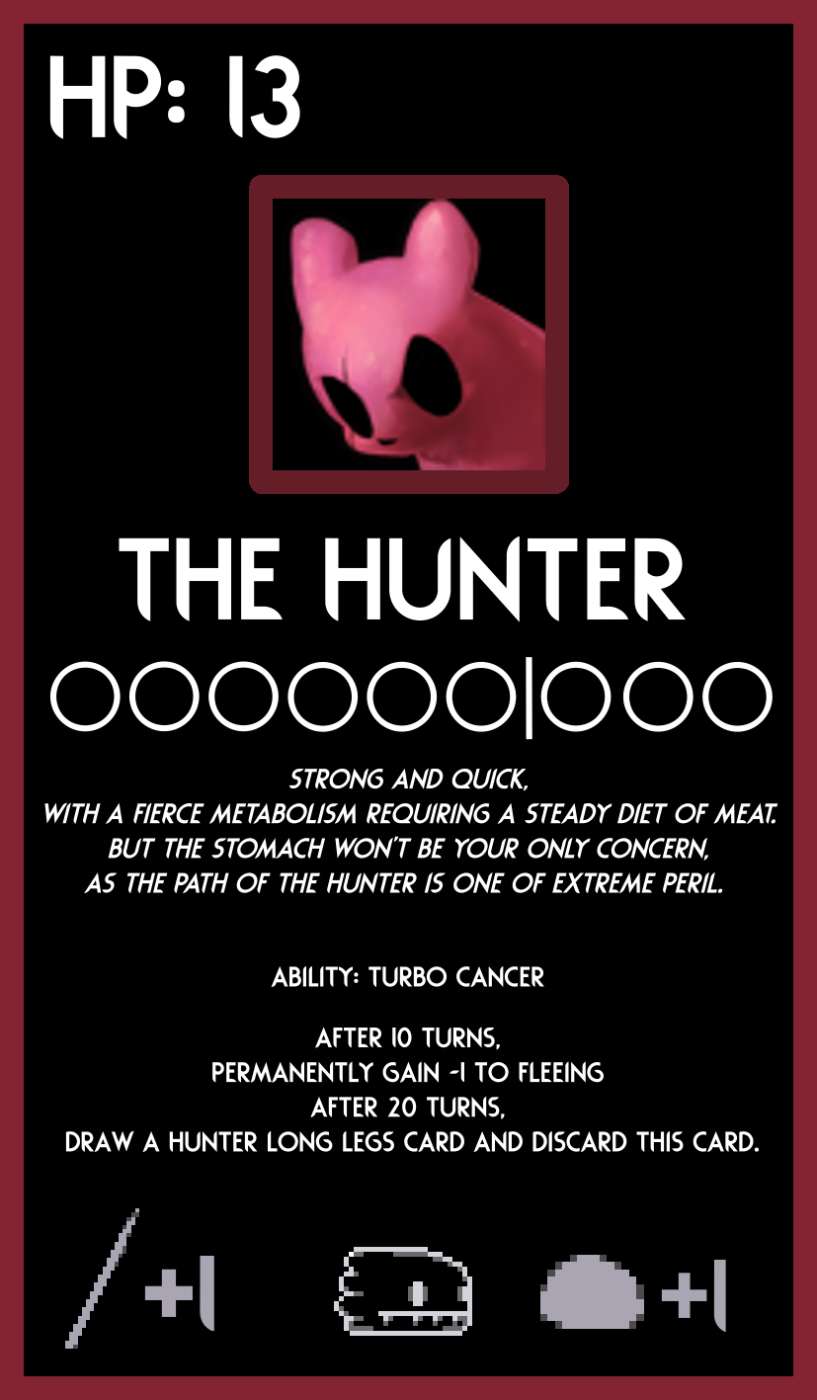
Labelled Cards
Labeled slugcat Card:
Your health
Food pips required to hibernate
And maximum you can have
Eats meat
your stats

Slide 7
Cycles + Rain
Cycles occur once the game has started and immediately after one cycle ends (all players are either dead or asleep). When a cycle begins, The player who takes the first turn will roll a die* and note down the number, this is the rain timer, then the first player takes their turn. After all players take their turns, lower the rain timer by 1.
a cycle ends when either all players are hibernating or if he rain timer hits -1, if any players are not hibernating by this point, they die. When a cycle ends if players are hibernating, they pickup the next respective karma token, otherwise they pickup the previous respective karma token. Aswell as this, player discard any creature cards (that are not tamed or a slugpup) and all their food pips.
precycles
Additionally, if you want you can roll a d20 at the start of every cycle, if it lands on a 1 this cycle is now considered a precycle.
During a precycle you must add +2 to the rain timer at the beginning and all players must pickup from the precycle deck, this deck has a bigger variety of creatures, less food and players must only pick up from it for their first 3 turns, after that they can pickup from their own region deck or the precycle deck. (WARNING! precycle deck does not contain gates to other regions and only has enough shelters for 4 players.)
*with 1-3 players roll a D8+2, with 4+ players roll a d6+2

Slide 8
Turns + Hibernation
On their turns, players can draw a card from their respective region deck, they can also draw a food token instead of a card and players can use item cards anytime within their turns.
If you draw a creature card, you must initiate combat with it unless stated otherwise. If nothing else happens they end their turn.
Once all Players turn’s have ended the cycle count depletes by one.)
On any turn, When you pull a shelter card you can either A. Hibernate, or B. take it with you which allows you to fast travel back to it at the cost of 1 turn. You can also search the deck for a shelter card at the cost of three turns.
To hibernate, you must have enough food pips (indicated by the line between empty pips on your food board)
When you hibernate, refer to what is said at the end of cycles+rain.
Starvation
If you do not have enough food pips to hibernate, you may starve by removing all food pips to survive the end of the cycle (as long as you have a shelter card). The next cycle you will have -1 to both attacking and fleeing and you must fill your entire board with food pips to hibernate.

Slide 9

Karma
Karma is used for travelling to different regions and is show in the form of a token.
You gain karma (discard current and pickup the next level) whenever you successfully hibernate, and you lose karma (discard current and pickup the previous level) when you die.
Regions will require certain amounts of karma to get to, if you have less than the amount you cannot go to that region however, if you have the same or more than the required amount you are fine to travel to that region.
There are five karma levels as shown in the bottom left.
The rest of karma is fully explained on the regions page.

Slide 10
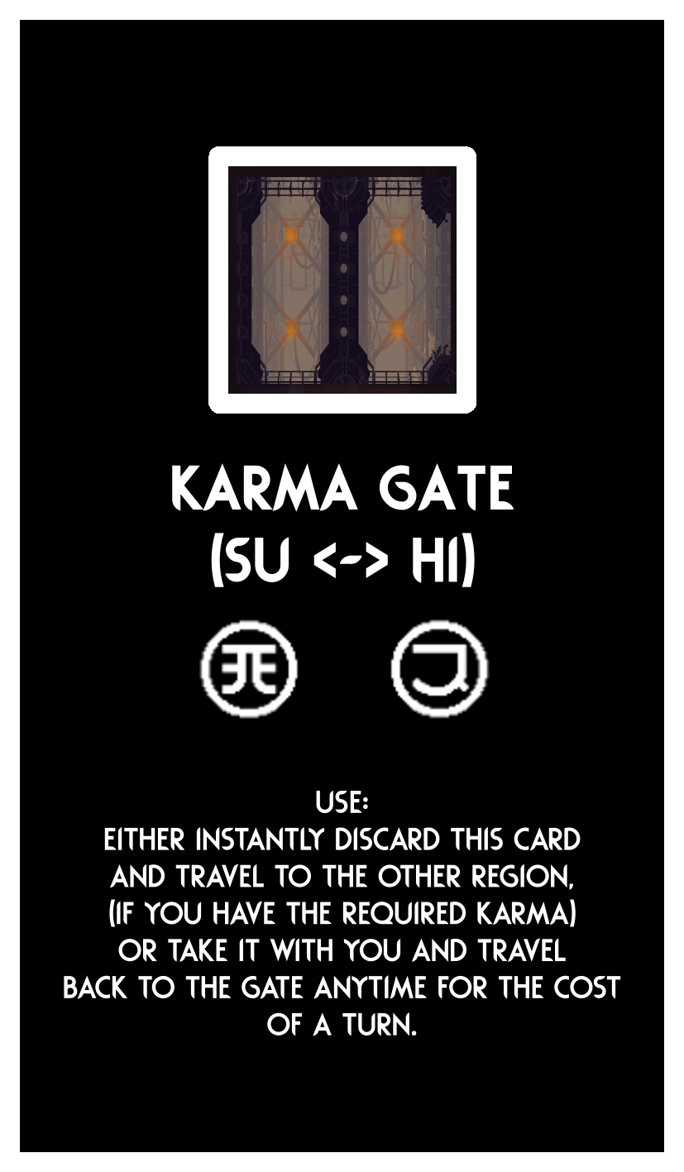
Regions
Travelling:
Travelling to different regions requires a gate card, you can obtain these from the deck of the region you are in. you must discard all shelter cards when traversing regions.
Below is a diagram of a gate card
Karma required to go from hi
(Industrial complex) to su (outskirts)
Karma required to go from su (outskirts) to hi
(Industrial complex)

Slide 11
Regions
Each region and their debuffs / traits:
- Outskirts (su)
- Industrial Complex (hi)
- Chimney Canopy (cc)
- Garbage Wastes (Water Based) (GW)
- Shoreline (Water Based) (SL)
- Shaded Citadel (-1 attack and -1 fleeing unless have a lantern) (SH)
- Sky Islands (-1 fleeing) (SI)
- Five Pebbles (Infinite Turns) (SS)
- The Wall (Can travel to the Underhang for no Karma Cost) (UW)
- The Underhang (Can travel to the Wall for no Karma Cost) (UW)
- Farm Arrays (Pick Up a Worm Grass card every two turns) (LF)
- Drainage System (Water Based) (DS)
- Subterranean (see ending the game) (SB)

Slide 12
Combat
When you pick up a creature card you must then attack, flee or tame the creature, you must roll higher than the creature health to attack, you must roll higher than the opposing creature to flee.
on the card will be the amount of food pips it is worth, and how many it takes to tame the creature; certain items make it easier to do this.
You take the first turn, either fleeing, attempting to tame or attacking the creature.
If the creature is still alive after your turn, it will then roll against you. Some creatures can attack you first such as stealth creatures E.g. a white lizard. You may also play any tamed creatures to help attack the opposing creature. Tamed creatures take their attacking turns after you.
When in the same region as a player you can use your turn to hunt them down, Then you can attack them the next turn the same way you attack a creature. You may also play any tamed creatures to help attack them.
If your enemy successfully flees from you, you cannot attack them again that cycle

Slide 13
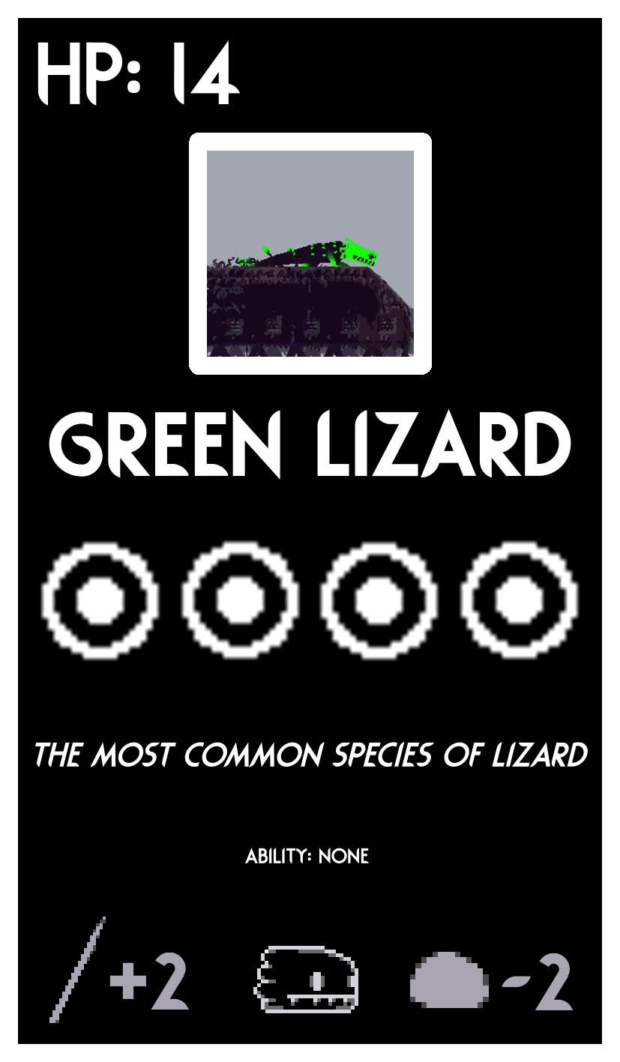
Combat
Labeled Creature Card:
Creature’s health
Food pips required to tame.
Also, the amount of food
You get for killing it.
Eats meat
Creature's stats

Slide 14
Scavengers
Scavengers have a reputation with each individual players, these can be raised or lowered due to certain actions and come with benefits and drawbacks.
When you encounter a scavenger, you can do three things;
Attack it which will lower your reputation by 1. If you kill it, draw a card for the scavenger treasury deck.
Give it items, for every 0.5 pearls you give them, increase your reputation by 1
Flee from it, this will do nothing to your reputation
You can have from 1-5 reputation and all players start at 1 reputation and artificer cannot gain any reputation
Reputation levels:
1-2: scavengers attack you
3-4: Scavengers ignore you unless you attack them first (you can flee with no roll)
5: when you encounter a scavenger, ignore its ability and add it to your hand as a friendly creature.
(You may have up to three scavengers in your hand.)
Trading:
When you encounter a scavenger merchant you draw three cards at random from the scavenger treasury deck and can
trade for them if you have items with enough value (pearl icon).

Slide 15
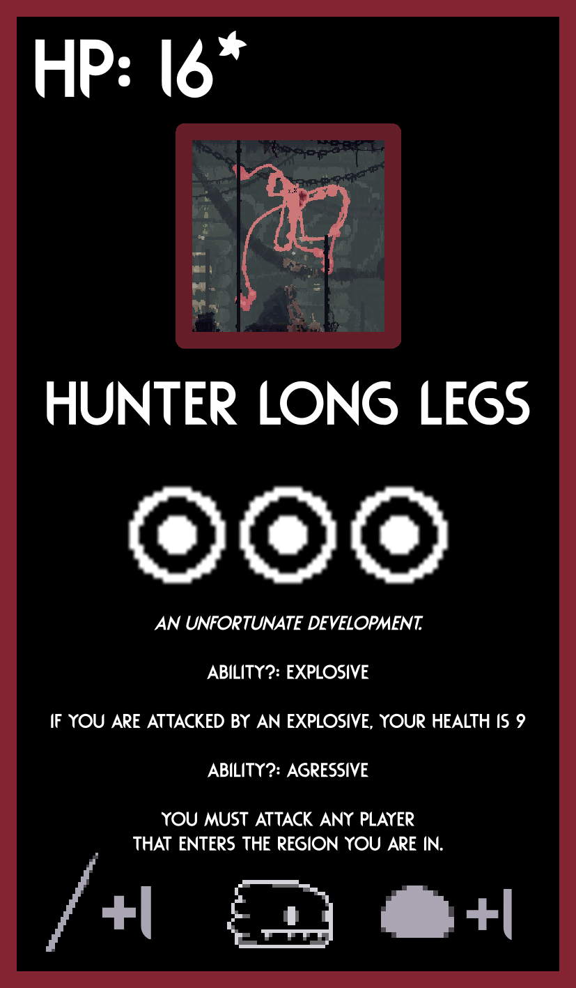
Unique Cards explained
Hunter Long legs:
If no one is playing the hunter,
shuffle this card into any deck and
Play with it as just a regular creature
card.
If someone is playing the hunter then after 20 turns, they discard “the hunter” card and instead use this as their slugcat card (you still use the hunter’s food bar. But other players can eat you for 3 food pips if they kill you,)
unlike slugcat cards, you are a creature and
Therefore, you can be tamed. If you are tamed, you are forced to follow the player that tamed you and aid them in combat if they ask you to. However, you may still take your own turns, and you can both shelter or travel regions if one of you has a shelter card or gate card. If your owner dies you become untamed

Slide 16
And that’s all!
Thank you for playing (or just reading about) my silly board game!
If you have any questions, please leave a comment on item’s the steam workshop page and I will try to respond!
If you have any ideas of something to add to the rulebook / helpbook, or just to the game, let me know!
Special thanks to:
Me (Huntress),
Trans people,
my friends,
my family,
Videocult for making Rain world!,
downpour team for making downpour!,
And like other people that I may have forgotten.

